Slide 1
CBS1A01P Fun with Language
Lecture 10
方言、口音、語言保育

Slide 2
今天的主題
語言、方言
方言之間的分別
語音：口音 accents
詞匯
語法
語言保育

Slide 3
語言和方言
語言 language 和 方言 dialect
方言、地方語言：特定地理區域中，某中語言的變體 a geographical variant of a language
目前社會語言學區別兩者的標準是以「相互溝通 / 相互可理解性」(mutual intelligibility) 為基礎：
任何可以相互溝通的稱為方言
不能相互溝通的稱為語言

Slide 4
語言和方言
但有時候，「相互可理解性」實際上無法解釋「語言」和「方言」的區別：
有些本來可界定為方言的，卻習慣上被認為是不同的語言

Slide 5
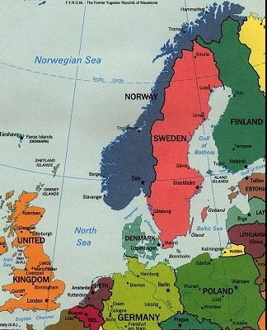
語言和方言
Norwegian 挪威語
Danish 丹麥語
相互溝通程度：
Norwegians understand 73% of spoken Danish
Danes understand 69% of spoken Norwegian (http://robertlindsay.wordpress.com/2009/05/29/some-scientific-intelligibility-studies/)
為甚麼是不同語言而非方言?

Slide 6
some statistics of the world’s languages
Lewis (2009):
~6900 languages in the world
389 (~6%) of the world’s languages have at least one million speakers and account for 94% of the world’s population
the remaining 94% of languages are spoken by only 6% of the world’s people
languages with >= 100 million native speakers:
Mandarin, Spanish, English, Arabic, Hindi, Bengali, Portuguese, Russian, Japanese
Lewis, M. P. (Ed.), 2009. Ethnologue: Languages of the World, (16th ed.). Dallas, Texas: SIL International. Online version: http://www.ethnologue.com/16

Slide 7
Ethnologue 民族語言網
提供不同語言的使用人口、分佈等資料的網站
“Since the fifteenth edition (2005), Ethnologue has followed the ISO 639-3 inventory of identified languages (http://www.sil.org/iso639-3) as the basis for our listing of languages.”
見下一頁

Slide 8
Ethnologue 民族語言網
“The ISO 639-3 standard applies the following basic criteria for defining a language in relation to varieties which may be considered dialects:
Two related varieties are normally considered varieties of the same language if speakers of each variety have inherent understanding of the other variety at a functional level (that is, can understand based on knowledge of their own variety without needing to learn the other variety).”

Slide 9
Ethnologue 民族語言網
(continued from the previous slide)
“Where spoken intelligibility between varieties is marginal, the existence of a common literature or of a common ethnolinguistic identity（語族認同）with a central variety that both understand can be a strong indicator that they should nevertheless be considered varieties of the same language.”

Slide 10
Ethnologue 民族語言網
(continued from the previous slide)
“Where there is enough intelligibility between varieties to enable communication, the existence of well-established distinct ethnolinguistic identities （語族認同） can be a strong indicator that they should nevertheless be considered to be different languages.”

Slide 11
漢語方言
Norman (1988, p. 181):
“The traditional classification is mainly based on a single criterion – the development of the Middle Chinese voiced stops into the modern dialects.”
Norman, J. (1988). Chinese. Cambridge: Cambridge University Press.
林燾、王理嘉 (1995，頁 158)：
“古代的全濁聲母在現代漢語大多數方言裡都已經變成了全清或次清聲母，只有吳方言和湘方言還保存著全濁聲母”
林燾、王理嘉 (1995)。語音學教程。台北：五南圖書出版公司。

Slide 12
漢語方言
主要以與中古漢語的繼承關係來劃分
漢語方言
北方方言/官話方言 以北京話為代表
粵方言 以廣州話為代表
客家方言 以梅州話爲代表
閩南方言 以廈門話為代表
閩北方言/閩東方言 以福州話為代表
贛方言 以南昌話為代表
湘方言 以長沙話為代表
吳方言 以蘇州話為代表

Slide 13
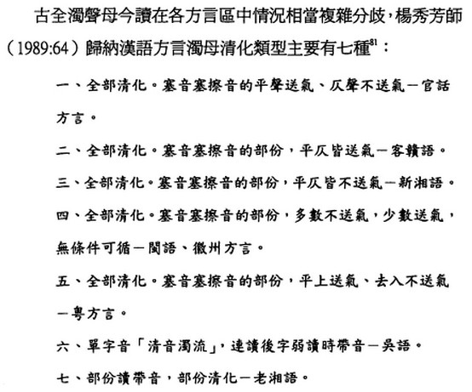
漢語方言
周玟慧（2005）。從中古音方言層重探《切韻》性質（頁114）。國立臺灣大學出版中心。

Slide 14
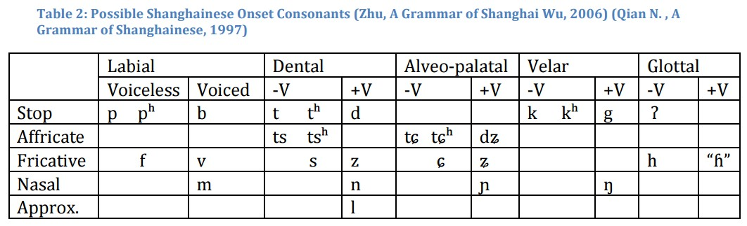
漢語方言
例子：上海話
Wellman, L. (2013). Pudong and Putonghua: Sound Change and Language Shift in Shanghai. http://ling.yale.edu/sites/default/files/files/alumni%20senior%20essays/Wellman,%20Laura%20-%20Senio%20Essay.pdf
“Shanghainese voiced stops, affricates and fricatives are only truly voiced inter-vocalically [出現在元音之間]”

Slide 15
粵方言
《中國大百科全書·語言文字》（1988）。上海：中國大百科全書出版社：
“粵方言又稱粵語，俗稱廣東話、廣府話，當地人稱白話，是漢語七大方言區中，語言現象較為複雜，保留古音特點和古詞語較多、內部分歧較小的一個方言。通行地域包括廣東及廣西境內，以廣州話為中心。使用人口約4000萬。”

Slide 16
粵方言
《中國大百科全書·語言文字》（1988）。上海：中國大百科全書出版社：
“粵方言通行地區大致有三： 一. 廣東省境內純粹屬粵方言或以粵方言為主的縣市有47個，佔全省面積三份之一以上，其中包括廣州、佛山、肇慶、台山、香港等。 二. 廣西壯族自治區通行粵方言的縣市有23個，包括南寧、橫縣、貴縣、桂平等。 三. 海外華僑及華裔中以粵方言為母語的也很多，主要分佈在東南亞、南北美洲、澳大利亞等。美洲的華僑和華裔幾乎百份之九十以上的祖籍都是粵方言區。”

Slide 17
粵方言
《中國大百科全書·語言文字》（1988）。上海：中國大百科全書出版社：
“粵方言區內部按其語言特點及地理分佈可以分為4部份。 一. 以廣州話為代表，是粵方言中使用人口最多、通行範圍最廣的。 二. 以台山話為代表。 三. 以陽江話為代表。 四. 以南寧話為代表。”

Slide 18
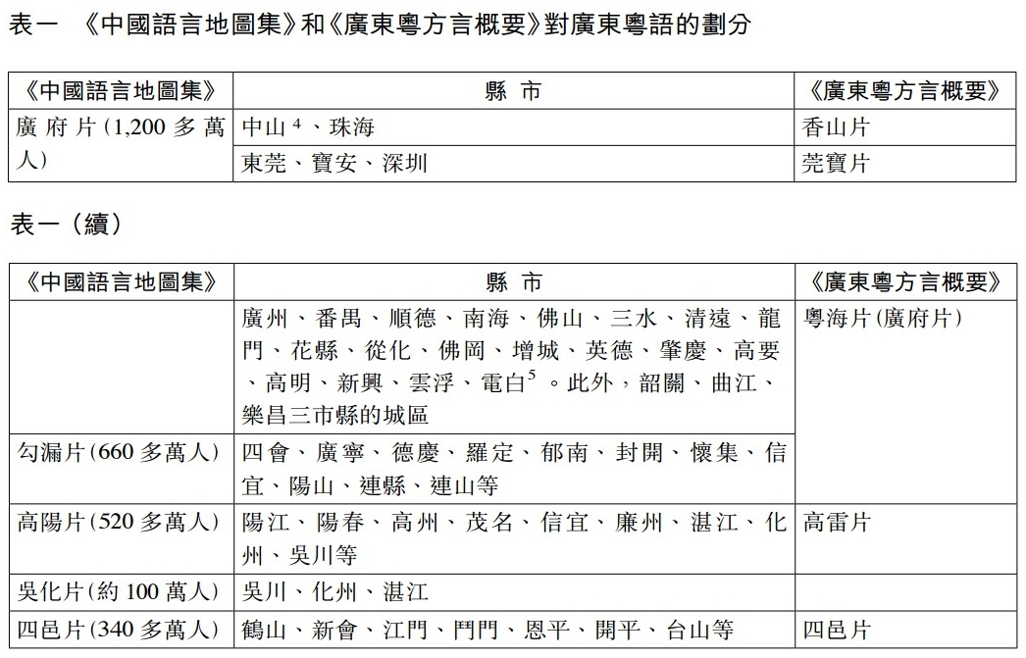
粵方言
http://www.cuhk.edu.hk/ics/journal/articles/v48p407.pdf
張雙慶、莊初昇（2008）。廣東方言的地理格局與自然地理及歷史地理的關係。《中國文化研究所學報》。

Slide 19
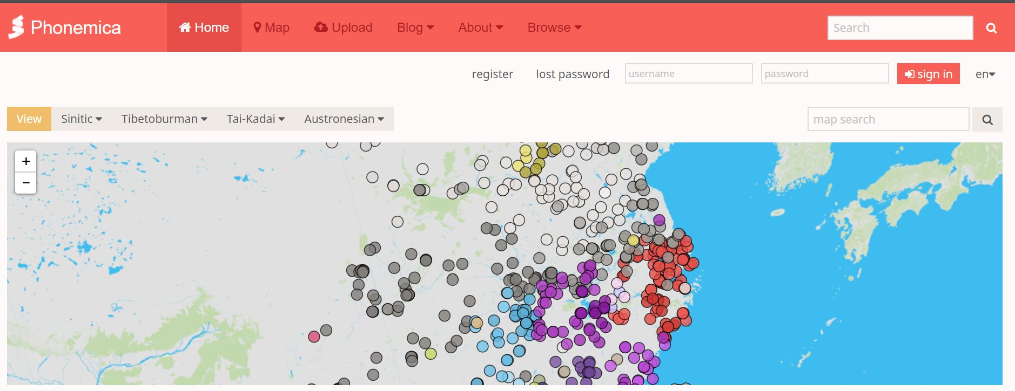
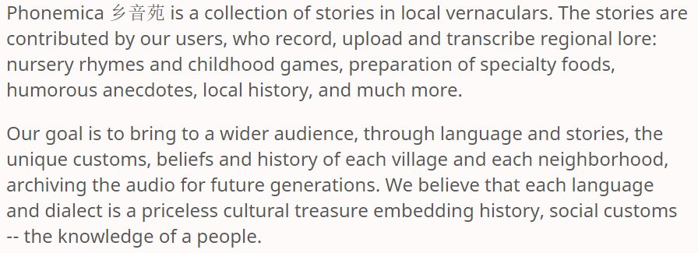
鄉音苑 http://phonemica.net/

Slide 20
語言和方言
許多人誤以為語言才是標準的，是教育、廣播、政府機關必須使用的唯一語言，而方言則是地方性、鄉土性的溝通工具，不能登大雅之堂
其實這種看法並不正確，因為任何語言都有至少一個以上的方言，而其中的一個方言必然會成為優勢方言，並扮演標準的角色

Slide 21
方言之間的分別
Phonological differences 語音
accent 口音
Lexical differences 詞匯
words
spelling
Syntactic differences 句法

Slide 22
Phonological differences 語音的分別
accent 口音 / 方音 / 腔
the way of pronouncing a language
留意 accent 這詞的其中兩種用法：
(1) native speakers 母語人士的口音
e.g., English: British accent, American accent, Australian accent,
(2) foreign speakers 非母語人士的口音
e.g., Hong Kong English accent

Slide 23
accents 口音
介紹以下影片中幾位主角的英語口音：
My Fair Lady 《窈窕淑女》 (1964)
取材自愛爾蘭劇作家蕭伯納（George Bernard Shaw）的舞台劇《賣花女》（Pygmalion, 1912）
描述一名上校（Colonel Hugh Pickering）與一名語音學教授（Professor Henry Higgins）打賭，看教授是否能將來自社會低層的賣花女（Eliza Doolittle）訓練成一名氣質高雅的淑女，讓人相信她真的是來自上流社會

Slide 24
英語口音例子：Cockney
Cockney, a London accent, the broadest London working-class speech
prominent features include:
1. H dropping hit, house, hammer
2. glottal stop water = wa’er, city = ci’y
3. TH fronting thin = fin, three = free
4. Yod dropping/coalescence (/j/ after an alveolar consonant)

Slide 25

英語口音例子：General American
prominent features include:
1. a rhotic accent: /r/ is pronounced in words in which the letter r appears in the spelling, like card, beard, dorm
2. /æ/ in words like bad, man is realized as [ɛː ~ eǝ]
3. yod dropping after alveolars e.g., /t(j), d(j), n(j)/ tune, duke, new
4. t tapping/voicing city; atom/Adam; shutter/shudder
“New York city” https://soundcloud.com/authenticjourneys/pronounce-newark-new-york (1:44)

Slide 26
R-dropping in English
non-rhotic varieties of English occur in:
Australia, Africa, England and Wales, Caribbean islands other than Barbados, most of New Zealand
rhotic varieties of English occur in:
USA, Canada, India, Ireland, Scotland, the extreme south of New Zealand

Slide 27
R-dropping in English
r-dropping happened in England in the 18th century
Ireland and the USA spoke English before this date
there are still rhotic speakers in the British isles; the rhotic accent is an instant code for the West Country and for the virtues of the rural life
the west of England: Cornwall, Somerset, Devon; western cities: e.g., Exeter, Bristol
non-rhotic accent in American port cities with close connections to Britain: e.g., New York City, Boston, Philadelphia, Alexandria, Charleston, and Savannah

Slide 28
accents 口音
BrE AmE
stop /stɒp/ /stɑːp/
water /ˈwɔːtə(r)/ /ˈwɔːtər/ /ˈwɑːtər/
sport /spɔːt/ /spɔːrt/
class /klɑːs/ /klæs/
different stress patterns:
address (n.) /əˈdres/ /əˈdres/ /ˈædres/
detail /ˈdiːteɪl/ /ˈdiːteɪl/ /dɪˈteɪl /
adult /ˈædʌlt/ /əˈdʌlt/ /ˈædʌlt/ /əˈdʌlt/

Slide 29
Lexical differences 詞匯的分別
examples:
British American
car park parking lot
lift elevator
petrol gasoline
lorry truck
trousers pants
pants = underpants underpants
British vs. American Words http://www.youtube.com/watch?v=PsBRsAlbzoI

Slide 30
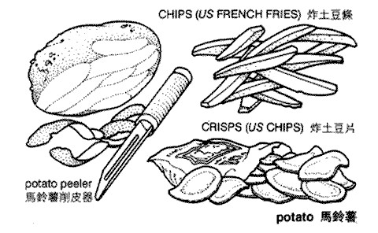

Lexical differences 詞匯的分別
chips, crisps
fish and chips

Slide 31
Lexical differences 詞匯的分別
examples of the differences in spelling:
British English American English
-our -or
-ise -ize
what words can you think of?
centre; metre center; meter
licence; defence license; defense

Slide 32
Syntactic differences
一個例子: expressing possession
two forms: Have or Have got
以下每一對句子意思上有沒有分別？
Do you have a car? Have you got a car?
He hasn't got any friends. He doesn't have any friends.
She has a beautiful new home. She's got a beautiful new home.

Slide 33
Syntactic differences
both forms are accepted in both British and American English
have got (have you got, he hasn't got, etc.): generally the preferred form in British English
have (do you have, he doesn't have etc.): generally the preferred form in American English

Slide 34
Syntactic differences
另一些例子：
BrE: I’ll go and take a look.
AmE: I’ll go take a look.
BrE: What did you do at the weekend?
AmE: What did you do on the weekend?

Slide 35
Ethnologue 民族語言網
Ethnologue
summary by language size
http://www.ethnologue.com/statistics/size

Slide 36
語言的消失與保育
語言的消失/死亡 the death of languages
懂得這語言的人越來越少
因不同原因不再繼續說這些語言
當再沒有人說這些語言

Slide 37
what languages are dying?
the United Nations Educational, Scientific, and Cultural Organization (UNESCO) 聯合國教育、科學及文化組織 (聯合國教科文組織)
4 levels of endangerment of languages
四種瀕危程度

Slide 38
Vulnerable: Most children speak the language, but it may be restricted to certain domains (e.g., home). 不安全型：該語言被大多數孩子使用，但或局限於某些場合 (例如：家中)
Definitely endangered: Children no longer learn the language as mother tongue in the home. 肯定瀕危型：該語言不再被孩子在家中作為母語學習

Slide 39
Severely endangered: Language is spoken by grandparents and older generations; while the parent generation may understand it, they do not speak it to children or among themselves. 嚴重瀕危型：該語言被祖父母輩及以上輩分的人們使用，父母輩可能懂得該語言，但不會用它與孩子及同輩交談

Slide 40
Critically endangered: The youngest speakers are grandparents and older, and they speak the language partially and infrequently. 極度瀕危型：該語言只被祖父母輩及以上輩分的人們使用，而他們也不能流利運用該語言

Slide 41
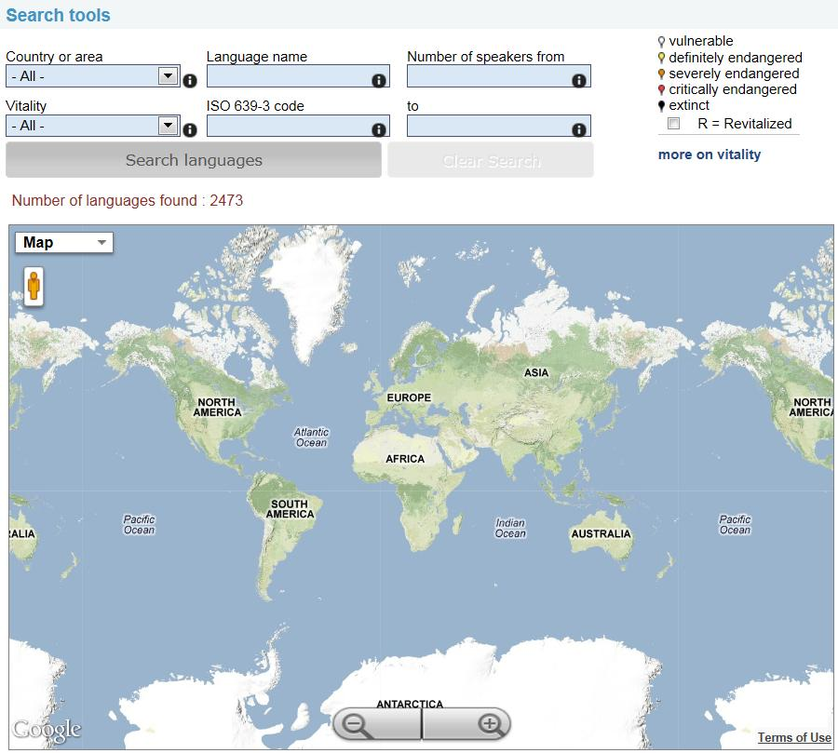
教科文組織世界瀕危語言地圖
UNESCO Atlas of the World's Languages in Danger
http://www.unesco.org/culture/languages-atlas/

Slide 42
對於保育語言之重要性的意見
Dr. Mark Turin:
“if we believe that this is part of our inherited condition as a species, this is what makes us unique as a species, it’s just a moral travesty not to do something about it”
http://www.youtube.com/watch?v=vNbm53Lm3T4

Slide 43
對於保育語言之重要性的意見
UNESCO, 1991:
“…the disappearance of any one language constitutes an irretrievable loss to mankind…”

Slide 44
對於保育語言之重要性的意見
Bouchenaki Mounir, assistant director-general of the UNESCO:
“Language is the carrier of the human intangible culture, and we should attach much importance to the protection of them”
http://english.peopledaily.com.cn/200507/22/eng20050722_197633.html

Slide 45
對於保育語言之重要性的意見
Ma Yongquan, a folk artist of the Zhuang ethnic group:
“The peculiar lingering charm and rules and forms of the folk songs could not be expressed in any other written language.”

Slide 46
“香港圍頭話客家話 50年後消失” (東方日報2011-12-11) http://orientaldaily.on.cc/cnt/news/20111211/00176_045.html “別以為廣州話是本港最地道的語言。 早在英國人租借新界之前，香港人主要是以圍頭話及客家話溝通，但現時識聽識講這兩種語言的卅歲以下市民，只餘不足百分之一，五十年後更可能再無香港人懂圍頭話及客家話。 為保存這獨特的語言遺產，有機構設立首個網上圍頭話、客家話發音字典，方便市民查閱。”

Slide 47
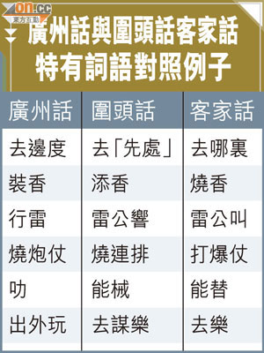
比較

Slide 48
對於保育語言之重要性的意見
each language provides new evidence on the nature of human cognition through its grammar
in its literature, poetry, ritual speech, and word structure, each language stores the collective intellectual achievements of a culture, offering unique perspectives on the human condition

Slide 49
對於保育語言之重要性的意見
the disappearance of a language is tragic; not only are these insights lost, but the major medium through which a culture maintains and renews itself is gone as well

Slide 50
對於保育語言之重要性的意見
a scientific reason for studying different types of languages:
linguists can develop a comprehensive theory of language that accounts for both its universal and language-specific properties

Slide 51
how do we preserve languages?
linguists attempt to preserve the endangered languages by
studying and documenting their grammars
recording for posterity the speech of the last few speakers

Slide 52
UNESCO, 1991 resolution:
“…the disappearance of any one language constitutes an irretrievable loss to mankind, it is for UNESCO a task of great urgency to respond to this situation by promoting…the description – in the form of grammars, dictionaries, and texts – of endangered and dying languages”

Slide 53
Ma Yongquan, a folk artist of the Zhuang ethnic group, the most populous ethnic group in the region, said he has been recording a lot of folk songs in the Zhuang language.
http://www.china.org.cn/english/2001/Jun/15169.htm

Slide 54
Guo Xiuming, a speaker of Gelo:
“I’ve been collecting Gelo folk cultural heritage from senior Gelao people in Guangxi since 1995, and so far I’ve compiled a collection of 70,000 words about that”
http://www.china.org.cn/english/2001/Jun/15169.htm

Slide 55
Dr. Mark Turin
http://markturin.commons.yale.edu/
“My research focuses on language endangerment and global cultural diversity. I am interested in language policy and activism in the context of mother tongue instruction...”

Slide 56
some success stories
a stunning example of the revival of a dormant language occurred in Israel
for centuries, classical Hebrew (希伯來語) was used only in religious ceremonies
but today, with some modernization, it has become the national language of IsraeI
the success story of Siletz
“Native Americans fight to preserve language”
http://www.youtube.com/watch?v=KQGlt_2cjII

